Slide 1
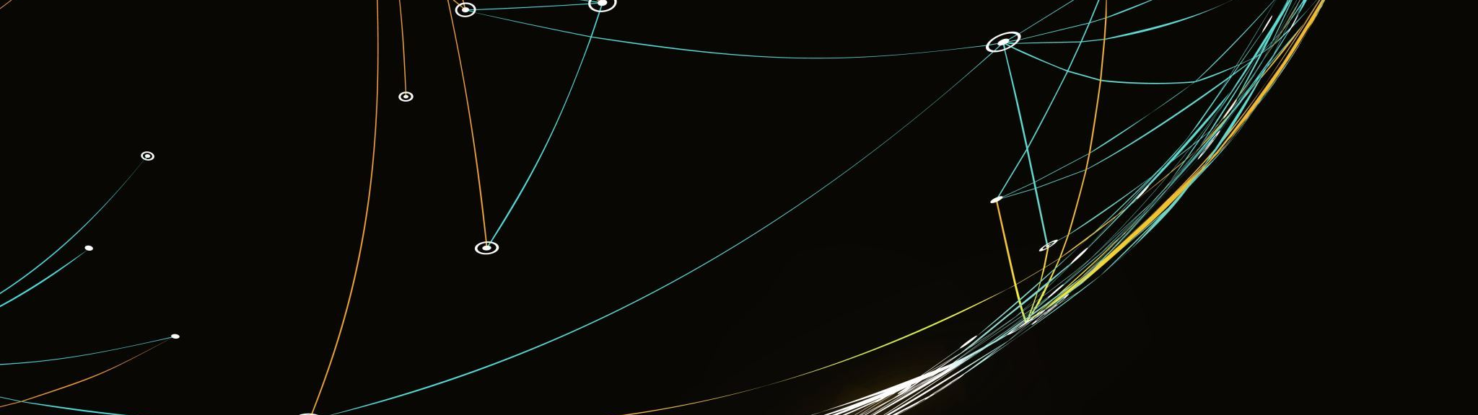
Country Clustering Analysis Using
Unsupervised ML
Temple University
Principles of Data Science
CIS 3715
Fuad Hassan

Slide 2
Project Objectives
Utilize unsupervised machine learning to categorize countries into four distinct clusters based on socio-economic and health factors: Highly Developed, Upper-Middle Developed, Lower-Middle Developed, and Least Developed.
Assist HELP International's decision-making process by identifying countries in the direst need of aid, allowing for a more strategic and effective distribution of $10 million in raised funds.
Provide insights into the relationships between different variables (e.g., child mortality rate, life expectancy, income, GDP per capita) to guide future policy decisions and targeted aid interventions.

Slide 3
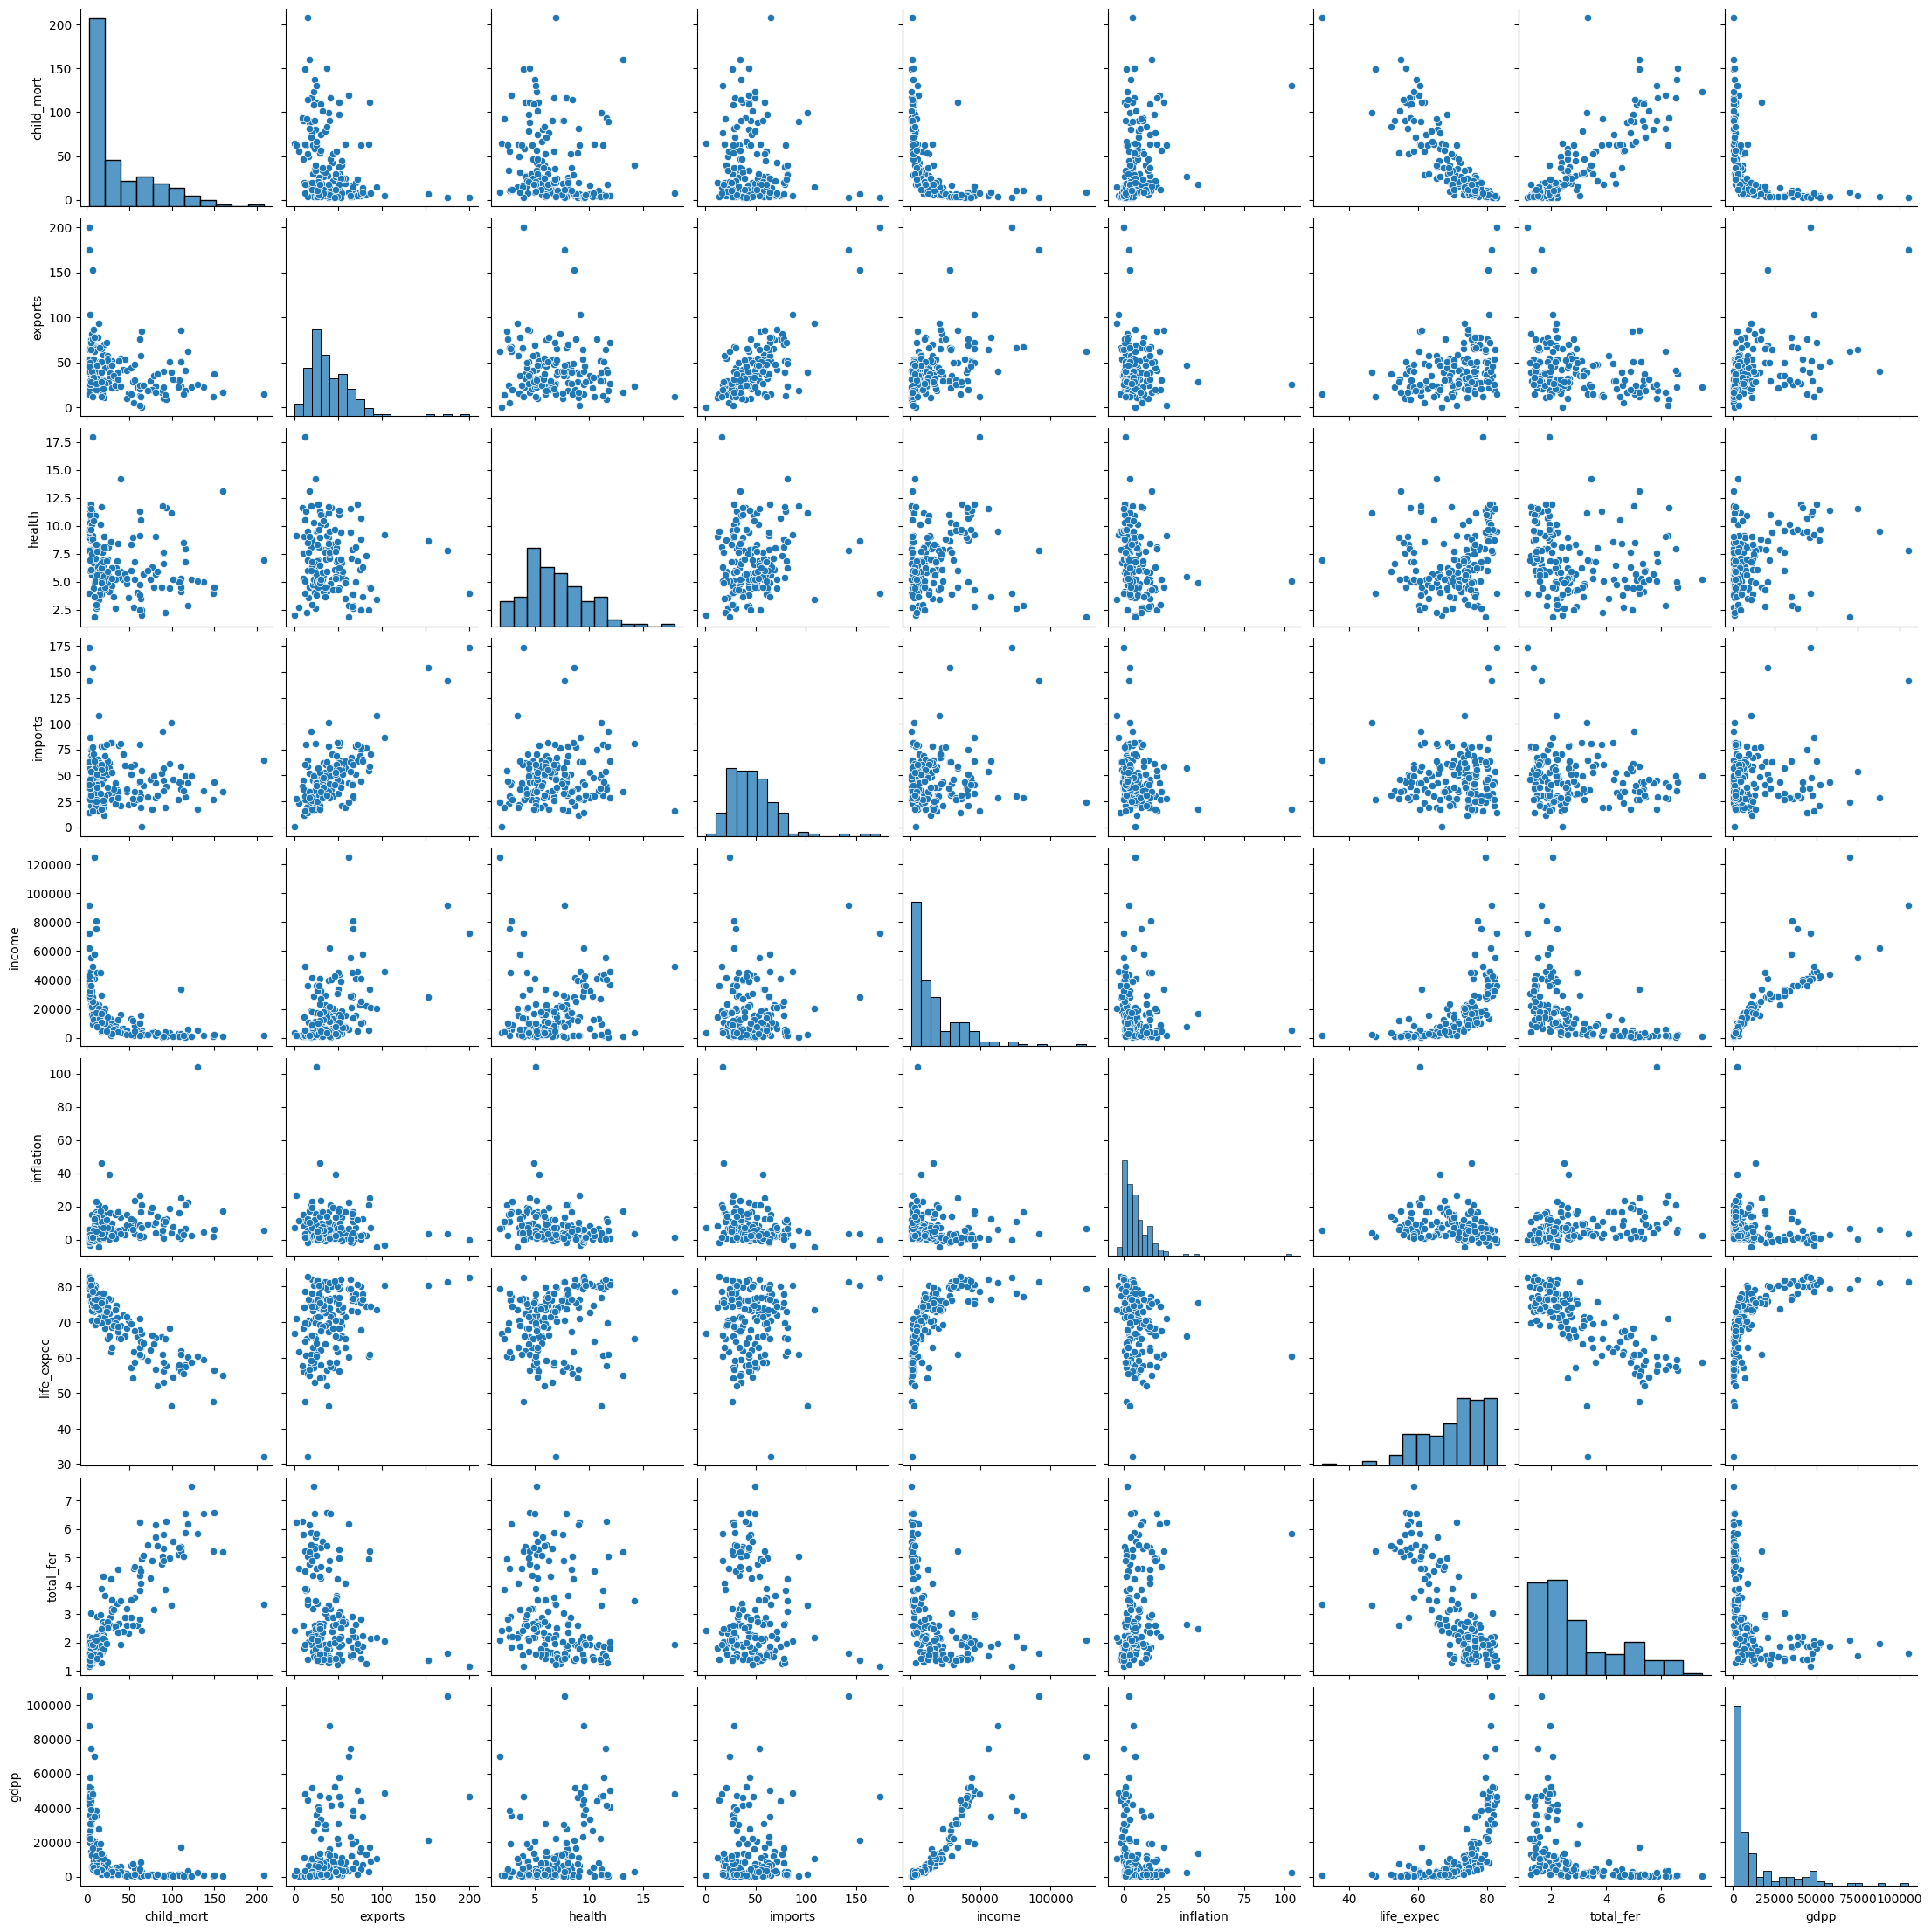
Description Of Data
country: Name of the country
child_mort: Child mortality rate (per 1000 live births)
exports: Exports of goods and services (% of GDP)
health: Total health spending (% of GDP)
imports: Imports of goods and services (% of GDP)
income: Net income per person
inflation: The measurement of the annual growth rate of the Total GDP
life_expec: Life expectancy at birth (in years)
total_fer: The number of children that would be born to each woman
if the current age-fertility rates remain the same
gdpp: Gross Domestic Product per capita

Slide 4
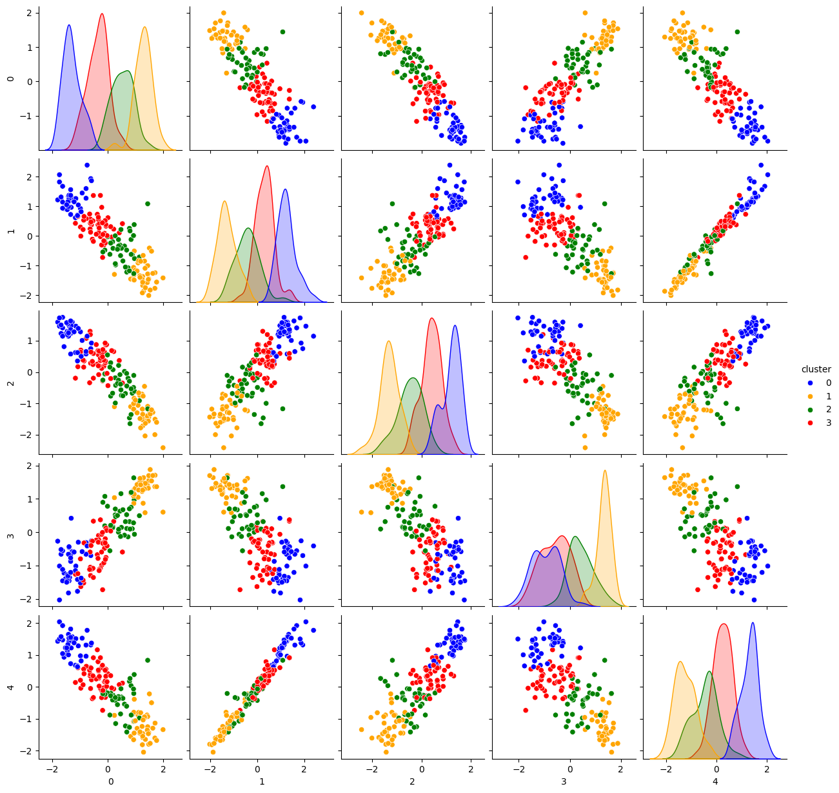
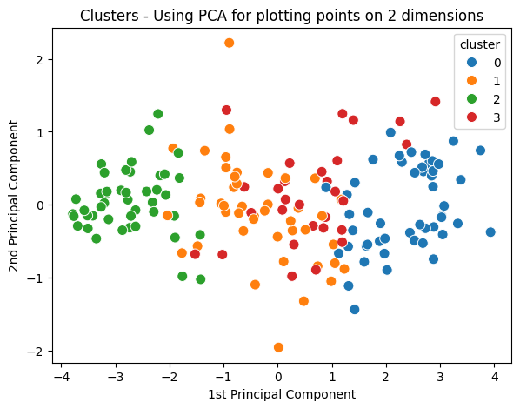
Model Description
After conducting feature extraction, I identified 'health,' 'imports,' 'inflation,' 'exports,' and 'cluster' as the most significant columns.
Utilizing these features, I executed a K-Mean clustering model with four clusters.
The 4 clusters have approximately same size: there’s no major outliers when it comes to the number of observations per cluster.

Slide 5
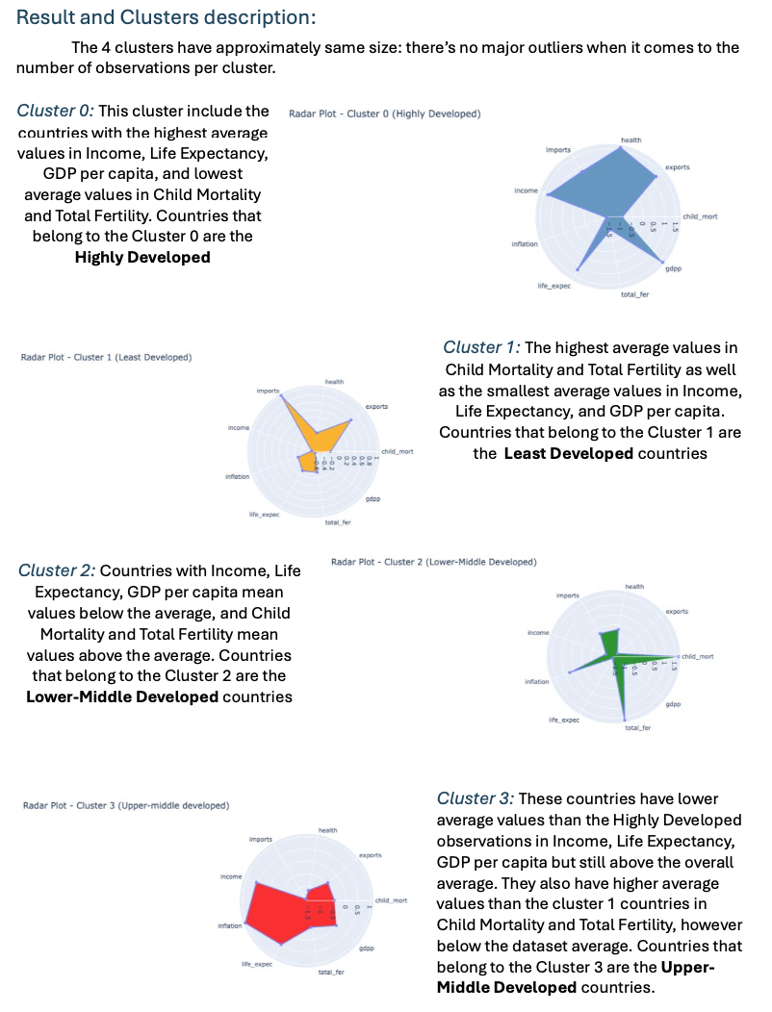
Description Of Results

Slide 6
